Slide 1
Hillier Building Applications for Office 365 and SharePoint with Angular 2

Slide 2








www.itunity.com/users/scot-hillier
www.criticalpathtraining.com
scot@scothillier.net
@ScotHillier
www.microsoftvirtualacademy.com/Studies/SearchResult.aspx?q=hillier
channel9.msdn.com/Search?term=hillier#ch9Search
www.pluralsight.com/search/?searchTerm=hillier

Slide 3
Agenda
Dev Tools and Resources
Angular 2 Framework
Site Pages
Add-Ins
SharePoint Framework

Slide 4
Development Environment
Visual Studio
Update 3 and ASP.NET Core 1.0
https://go.microsoft.com/fwlink/?LinkId=691129
TypeScript 2.0 beta npm install -g typescript@beta
Node.js Tools for Visual Studio https://beta.visualstudio.com/vs/node-js
Node
Node.js 5.3.0 https://nodejs.org/en/
Node Package Manager Windows Upgrade npm install -g npm-windows-upgrade
npm-windows-upgrade

Slide 5
Angular 2 Framework
Fundamentals

Slide 6
Introducing Angular 2
Description
Single-Page Application (SPA) Framework
Implements MV* (pronounced M-V-star) Pattern
Why Angular
True framework instead of patchwork of libraries
Strong separation of concerns
Why Angular 2
Significant improvements in speed
Supports latest JavaScript innovations like components, modules
Better mobile support

Slide 7
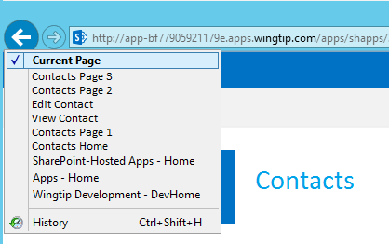
Single-Page Applications
App has one page
Different views are loaded dynamically
Routes are used to simulate pages
History list reflects route navigation
Id
First Name
Last Name
Id
1
First Name
Scot
Contacts.html
Last Name
Hillier

Slide 8
MV* with Angular 2
View
Component
Data
Model

Slide 9
Angular Building Blocks
Modules and Barrels
Components and Directives
Templates and Binding
Services and Dependency Injection

Slide 10
Modules and Barrels
//module
export class Welcome {
public static getMessage() {
return 'Hello, World!';
}
}
custom module
import module
//component
import {Welcome} from './app.module'
import {Component} from '@angular/core'
Import barrel

Slide 11
Components and Directives
import {Welcome} from './app.module'
import {Component} from '@angular/core'
@Component({
selector: 'app-main',
template: `<h1>${Welcome.getMessage()}</h1>`
})
export class AppComponent { }
Component associates HTML template with CSS selector
<tr *ngFor="let item of items">
<td>{{item.Title}}</td>
<td>{{item.Body}}</td>
</tr>
Structural directive adds elements to DOM
Attribute directive alters existing elements
<div [(ngModel)]="welcomeMessage"></div>

Slide 12
Important Built-in Directives
ngModel: binds component data to view
ngFor: for-each loop data binding
ngIf: conditional data binding
ngSwitch: switch-case data binding
ngStyle, ngClass: styles an HTML element

Slide 13
DEMO
Hello, Angular 2
Notes:
ASP.NET Core 1.0

Slide 14
Site Pages

Slide 15
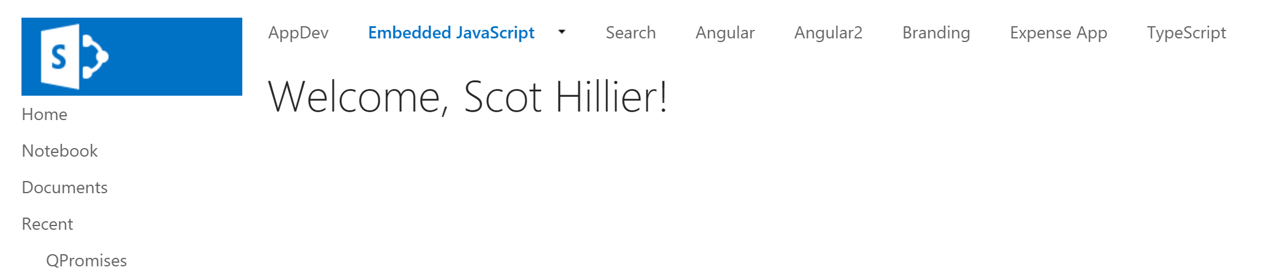
Site Page
<%@ Register TagPrefix="asp" Namespace="System.Web.UI" Assembly="System.Web.Extensions, Version=4.0.0.0, Culture=neutral, PublicKeyToken=31bf3856ad364e35" %>
<%@ Register TagPrefix="WebPartPages" Namespace="Microsoft.SharePoint.WebPartPages" Assembly="Microsoft.SharePoint, Version=15.0.0.0, Culture=neutral, PublicKeyToken=71e9bce111e9429c" %>
<%@ Import Namespace="Microsoft.SharePoint" %>
<%@ Assembly Name="Microsoft.Web.CommandUI, Version=15.0.0.0, Culture=neutral, PublicKeyToken=71e9bce111e9429c" %>
<asp:Content ID="PageHead" ContentPlaceHolderID="PlaceHolderAdditionalPageHead" runat="server">
<script type="text/javascript" src="/_layouts/15/sp.runtime.js"></script>
<script type="text/javascript" src="/_layouts/15/sp.js"></script>
<script src="https://code.angularjs.org/2.0.0-beta.0/angular2-polyfills.min.js"></script>
<script src="https://cdnjs.cloudflare.com/ajax/libs/es6-shim/0.34.1/es6-shim.min.js"></script>
<script src="https://code.angularjs.org/2.0.0-beta.0/Rx.umd.js"></script>
<script src="https://code.angularjs.org/2.0.0-beta.0/angular2-all.umd.min.js"></script>
</asp:Content>
<asp:Content ID="Main" ContentPlaceHolderID="PlaceHolderMain" runat="server">
</asp:Content>
<asp:Content ID="PageTitle" ContentPlaceHolderID="PlaceHolderPageTitle" runat="server">
Angular 2 Site Page
</asp:Content>
<asp:Content ID="PageTitleInTitleArea" ContentPlaceHolderID="PlaceHolderPageTitleInTitleArea" runat="server">
Notes:
Entire site pages can contain a custom UI and JavaScript

Slide 16
Sandbox Solutions
SharePoint 2013
Deprecated for use with code
Should only be used with
declarative CAML elements
Sandbox
CAML
Notes:
Sandbox solutions is only supported for declarative elements. Even for those, it is actively discouraged because it doesn’t clean up well when uninstalled.

Slide 17

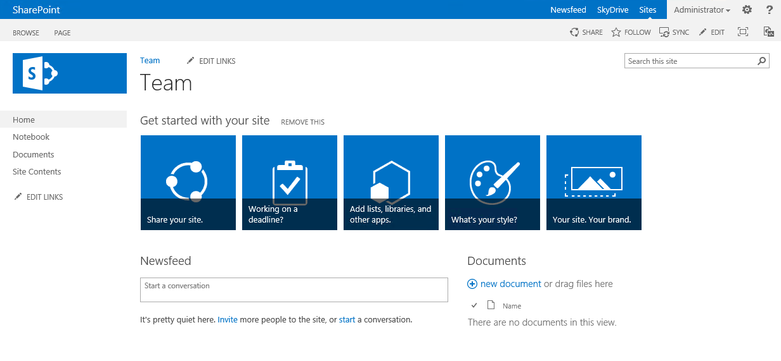
Sandbox Single-Page Application
SharePoint 2013
js
JS
Notes:
This is the IFF pattern of using a sandbox solution to deploy site pages and JS files that are SPAs.

Slide 18
DEMO
Site Page

Slide 19
Add-Ins

Slide 20
SharePoint-Hosted Add-In
SharePoint 2013
Host Web
App Web
Web Services
Notes:
SharePoint-hosted add-ins use a SharePoint site as the infrastructure

Slide 21
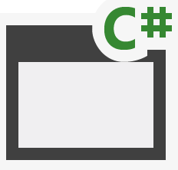
Provider Hosted Add-In (cloud)
SQL Azure
Azure Web Sites
Azure Data Market
aspx
png
master
CSS
js
SharePoint Online
Host Web
App Web
Notes:
Provider hosted add-ins use Azure in the cloud

Slide 22
Provider Hosted Add-In (on-premises)
Internet Information Server
Databases
Web Services
aspx
png
master
CSS
js
SharePoint 2013
Host Web
App Web
Notes:
Provider hosted add-ins use a separate IIS infrastructure on-premises

Slide 23
DEMO
SharePoint-hosted add-in

Slide 24
SharePoint framework
Client Web Part Basics

Slide 25
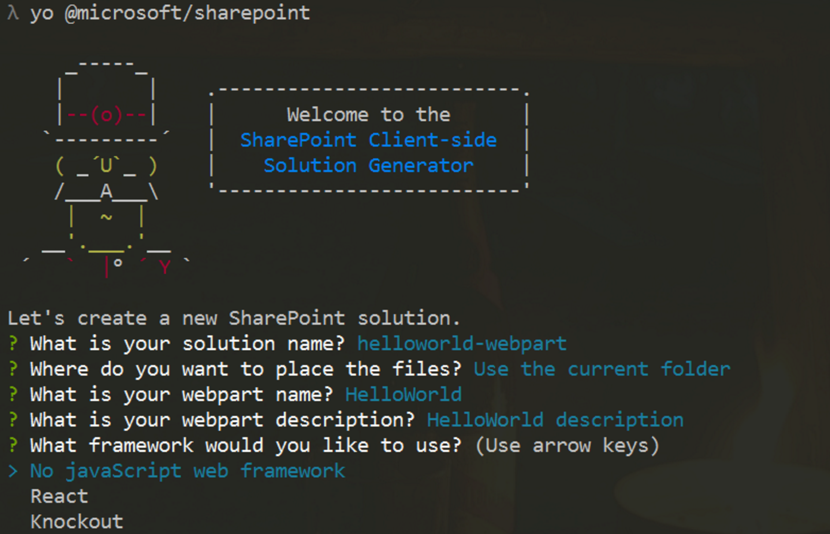
New Project Creation
Yeoman Generator
Creates initial project files
React and KO built-in
Angular 2 requires manual steps
yo @microsoft/sharepoint
Visual Studio 2015
Open created project for editing

Slide 26
Extending the BaseClientSideWebPart
export default class MyFirstKoWebPartWebPart extends
BaseClientSideWebPart<IMyFirstKoWebPartWebPartProps> {}

Slide 27
Rendering the WebPart
public render(): void {
}

Slide 28
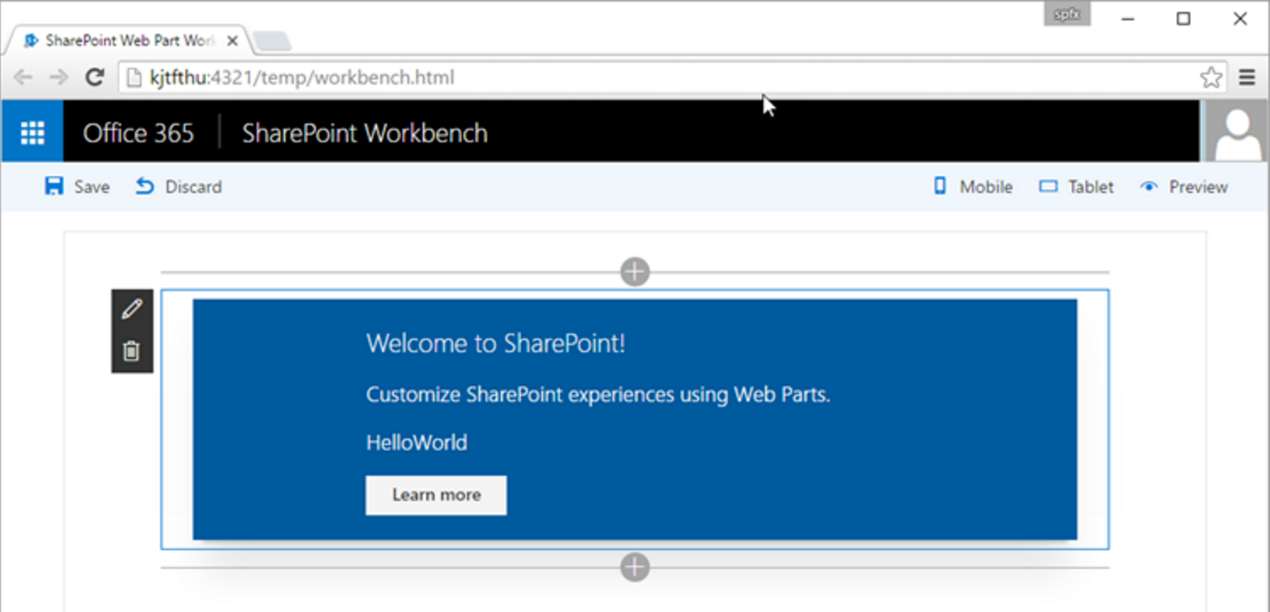
SharePoint Workbench
Local
For local testing
Office 365
Runs in the SharePoint context

Slide 29
Deployment
SharePoint
Create SPAPP package
Upload to App Catalog
Add to Site
CDN Support
Deploy assets to Azure
Reference in WebPart

Slide 30
DEMO
Client Web Parts
Notes:
Create a client web part with no framework
Run in local workbench
Run in Office 365 workbench

Slide 31
Summary
Dev Tools and Resources
Angular 2 Framework
Site Pages
Add-Ins
SharePoint Framework

